Slide 1

DRESSING ETIQUETTE
KATHIRAVAN A
IFET COLLEGE OF ENGINEERING.

Slide 2
INTRODUCTION
Dressing etiquette:
Dressing etiquette refers to the set of guidelines or rules for choosing appropriate attire for various occasions and settings.
Importance of Dressing Etiquette:
First Impressions and Company Image.
Professionalism and Respect.
Comfort and Functionality.

Slide 3

Business Formal Attire
Dress Shirt:
Choose a crisp, white or light-colored dress shirt. Ensure it is simple and elegant, avoiding overly bright colors or busy patterns.
Footwear:
Select polished, closed-toe shoes in neutral colors such as black or brown. Shoes should be comfortable yet professional, complementing the overall attire.
Accessories and Grooming:
Keep accessories minimal, such as a simple watch, earrings, or necklace. Ensure personal grooming is neat, including hair, nails, and overall hygiene.

Slide 4
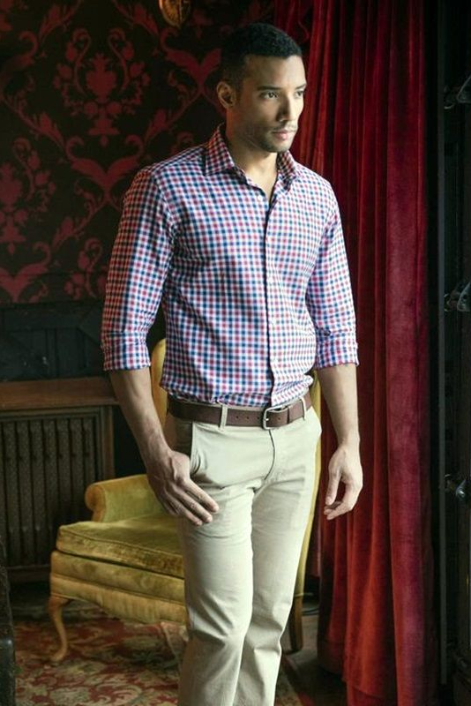
Business Casual Attire
Tops:
Shirts in neutral or muted colors. Patterns should be subtle, and the fit should be comfortable yet professional.
Bottoms:
Choose dress pants with minimal casual. Avoid overly casual options like jeans or shorts. The bottoms should be well-fitted and free of wrinkles.
Footwear:
Wear professional shoes such as loafers, dress shoes. Shoes should be clean and polished, maintaining a neat appearance without being overly formal.

Slide 5
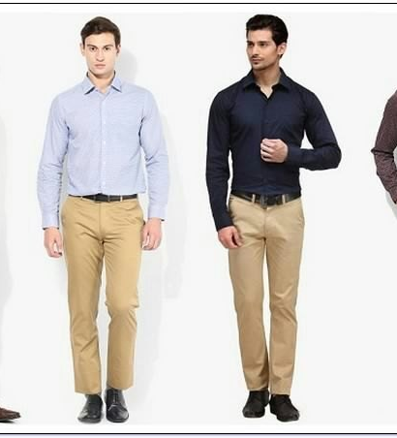
Importance of Formal Dressing
Professional Image.
Confidence and Competence.
Uniformity and Team Cohesion.
Respect and Etiquette.

Slide 6
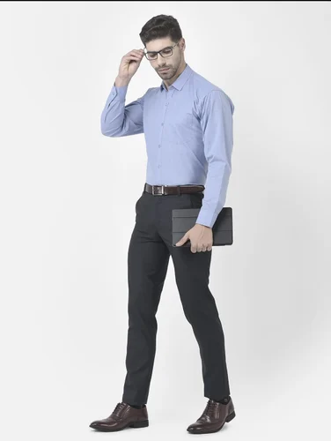
Formal Dressing for Men
Essential Items: Suit, tie, belt, dress shirt, dress shoes.
Suit: Well-fitted, preferably in neutral colors (black, navy, gray).
Shirt: Crisp, clean, and usually white or light-colored.
Tie: Conservative patterns and colors.
Shoes: Polished dress shoes.

Slide 7
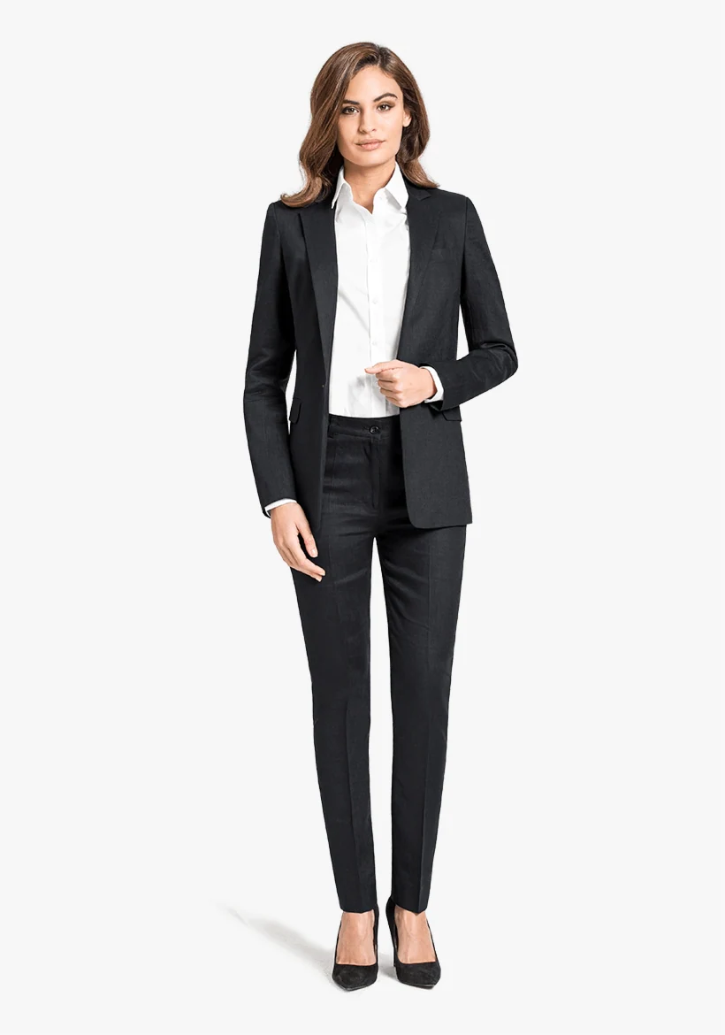
Formal Dressing for Women
Essential Items: Pantsuit or skirt suit, blouse, churidar, closed-toe shoes.
Suit: Tailored and professional, in neutral or dark colors.
Dress: Simple and elegant, avoiding overly bright colors.
Shoes: Comfortable but professional.
Accessories: Minimal and professional.

Slide 8
Do’s of Formal Dressing
Fit:
Ensure clothing is well-fitted and tailored.
Grooming:
Maintain a neat and tidy appearance.
Details:
Pay attention to small details like polished shoes and ironed clothes.

Slide 9
Don’ts of Formal Dressing
Overly Casual Items:
Avoid jeans, t-shirts, and sneakers.
Bright Colors and Flashy Accessories:
Stick to conservative colors and minimal accessories.
Wrinkled or Stained Clothes:
Always present yourself in clean, well-maintained attire.

Slide 10
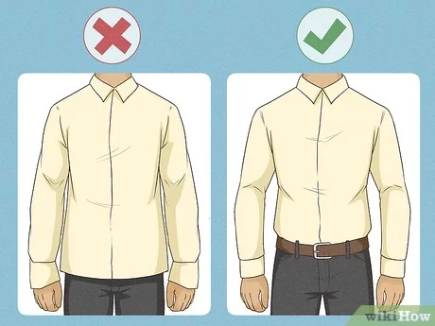
Common Dressing Mistakes
Overdressing /Underdressing.
Inappropriate Footwear.
Accessories.
Color combinations

Slide 11
Tips for choosing right Attire
Research the Dress Code.
Balance Comfort and Professionalism.
Consider the Work Environment and Your Role.
Tryout color combinations with help of Internet (Youtube..,)

Slide 12
Conclusion
The Impact of Dressing Well: Dressing attire affects personal and professional life.
Encouragement to Adhere to Dressing Guidelines: Motivate employees to follow the dress code to maintain a positive workplace culture.
Creates a strong unity: Gives confidence and improves the team cooperation.

Slide 13
Thank you

